Slide 1
CSC3100 Data Structures Tutorial 3
Wenjie Feng (USTF, SDS, 122090112@link.cuhk.edu.cn)
Acknowledgement: The tutorial materials are based on previous TA’s works. Thank them for their contribution!

Slide 2
Contents
Asymptotic Analysis
Concepts
Practice Problems
Complexity for recursion and divide-and-conquer
Concepts
Practice Problems
Coding Questions

Slide 3
1. Asymptotic Analysis
Evaluate the “efficiency” of an algorithm.
Commonly used notations:
Big-Oh notation: measure the upper bound complexity.
Big-Omega notation: measure the lower bound complexity.(Transition between Big-Oh and Big-Omega)
Big-Theta notation: Where Upper & lower bounds meet(Growth rate tight)

Slide 4
If meet
For some algorithm f(n), assume we can prove the greens:
O(1) O(log n) O(n) O(n·log n) O(n²) O(n³) O(2^{n})
^^^^^^^^
(minimum upper bound)
Ω(1) Ω(log n) Ω(n) Ω(n·log n) Ω(n²) Ω(n³) Ω(2^{n})
^^^^^^^^
(maximum lower bound)
The minimum upper bound and maximum lower bound meet
=> f(n) is Θ(n·log n)

Slide 5
If can’t meet
For some algorithm f(n), assume we can prove the greens:
O(1) O(log n) O(n) O(n·log n) O(n²) O(n³) O(2^{n})
^^^^^
(minimum upper bound)
Ω(1) Ω(log n) Ω(n) Ω(n·log n) Ω(n²) Ω(n³) Ω(2^{n})
^^^^^^^^
(maximum lower bound)
The minimum upper bound and maximum lower bound don’t meet
=>Usually, just use the upper bound. We will say f(n) is O(n²)

Slide 6
Some nice property for calculation
For Big-Oh and Big-Omega, we have:
Polynomial Rule: Only the biggest matter
Product Rule: the big multiplies the big
Sum Rule: the bigger of the two big
(Log Rule): Log only beats constant
(Exponential Rule): Exponential beats power functions

Slide 7
Practice Problems(1)
for (int i = 0; i < n; i++) {
// Some O(1) operation
}
for (int i = 0; i < n; i++) {
for (int j = 0; j < n; j++) {
// Some O(1) operation
}
}

Slide 8
Practice Problems(1)
for (int i = 0; i < n; i++) {
// Some O(1) operation
}
for (int i = 0; i < n; i++) {
for (int j = 0; j < n; j++) {
// Some O(1) operation
}
}
O(n)
O(n²)

Slide 9
Practice Problems(2)
for (int i = 0; i < n; i+=(n/2)) {
// Some O(1) operation
}
while (n > 0) {
if (n % 2 == 1)
res = res * a;
a = a * a;
n = n / 2;
}

Slide 10
Practice Problems(2)
for (int i = 0; i < n; i+=(n/2)) {
// Some O(1) operation
}
while (n > 0) {
if (n % 2 == 1)
res = res * a;
a = a * a;
n = n / 2;
}
O(1)
This algorithm is called “Quick Power”
O(log n)
More Info: https://www.rookieslab.com/posts/fast-power-algorithm-exponentiation-by-squaring-cpp-python-implementation

Slide 11
Practice Problems(3)

Slide 12
Practice Problems(3)
Idea：
“Product rule” apply for both Big-Oh and Big-Omega
Apply “Product Property”: 1st term’s : 0.1n^2 2nd term’s : nlogn
0.1n^2 is both 1st term’s Big-Oh and Big-Omega, so is nlogn
Thus, the product of them is also both Big-Oh and Big-Omega → Big-Theta!
Two key points:
Apply the rule to simplify the problem;
When proving Θ(·), we need to prove O(·) and Ω(·) together.

Slide 13
2. Complexity analysis for recursion and divide-and-conquer
To calculate the complexity for recursion and divide-and-conquer algorithm:
Step 1: Get the recursive expression (looks like: g(n) = g(n-1) + O(n), g(n) = g(n/2) + O(n) )
Step 2:
Method 1: Unfold g(n) to g(1) by hand and get the answer.
Method 2: Master theorem

Slide 14
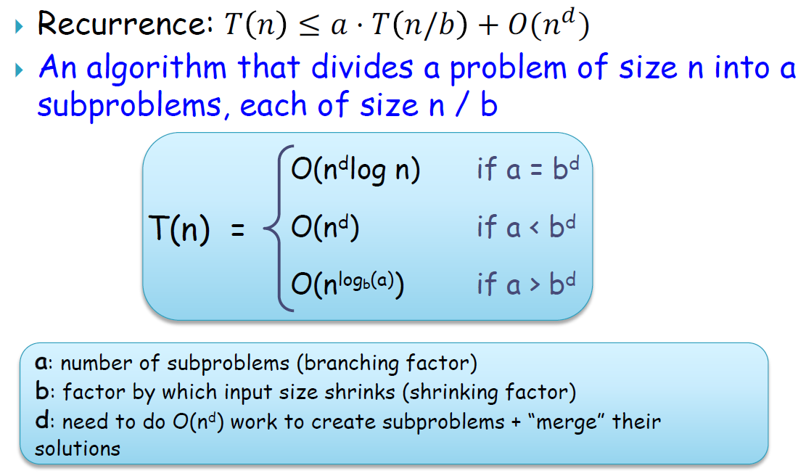
From Prof. Fang’s slides – lec 6 – page 19.

Slide 15
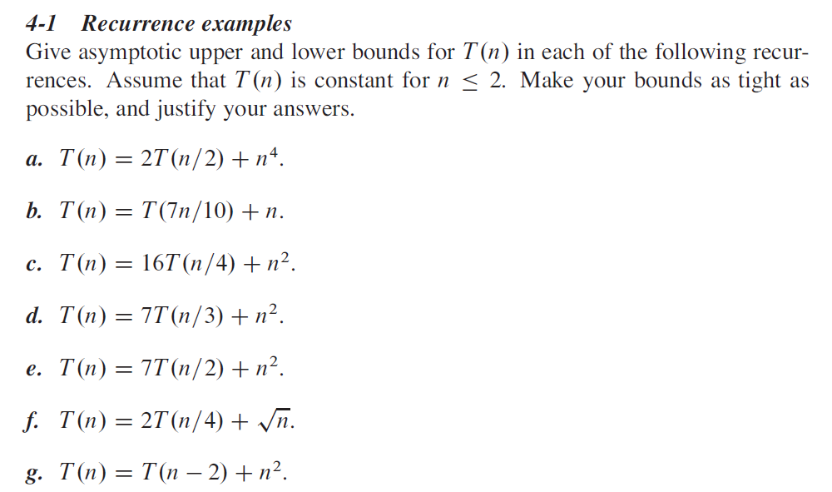
Let you be familiar with it!
Problem 4-1 (page 107, 3rd edition)

Slide 16
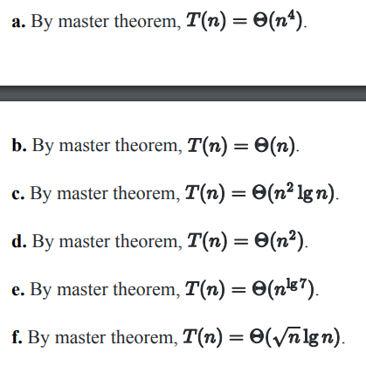
Question a-f: Use Master’s Theorem.

Slide 17
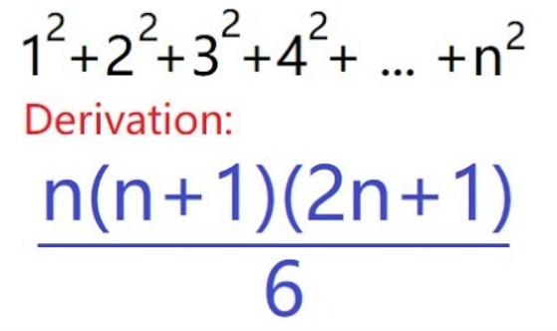
Question g: Expand the recursion
T(n) = T(n-2) + n²
= T(n-4) + (n-2)² + n²
= T(1) + 3² + …… + (n-4)² + (n-2)² + n² (If n is odd)
= T(2) + 4² + …… + (n-4)² + (n-2)² + n² (If n is even)
By the sum of the squares formula, We know that T(n) is Θ(n³).
Some small tricks in our case:
Even n: use formula with n=2k in it.
Odd n: use sum difference (total sum-even sum)

Slide 18
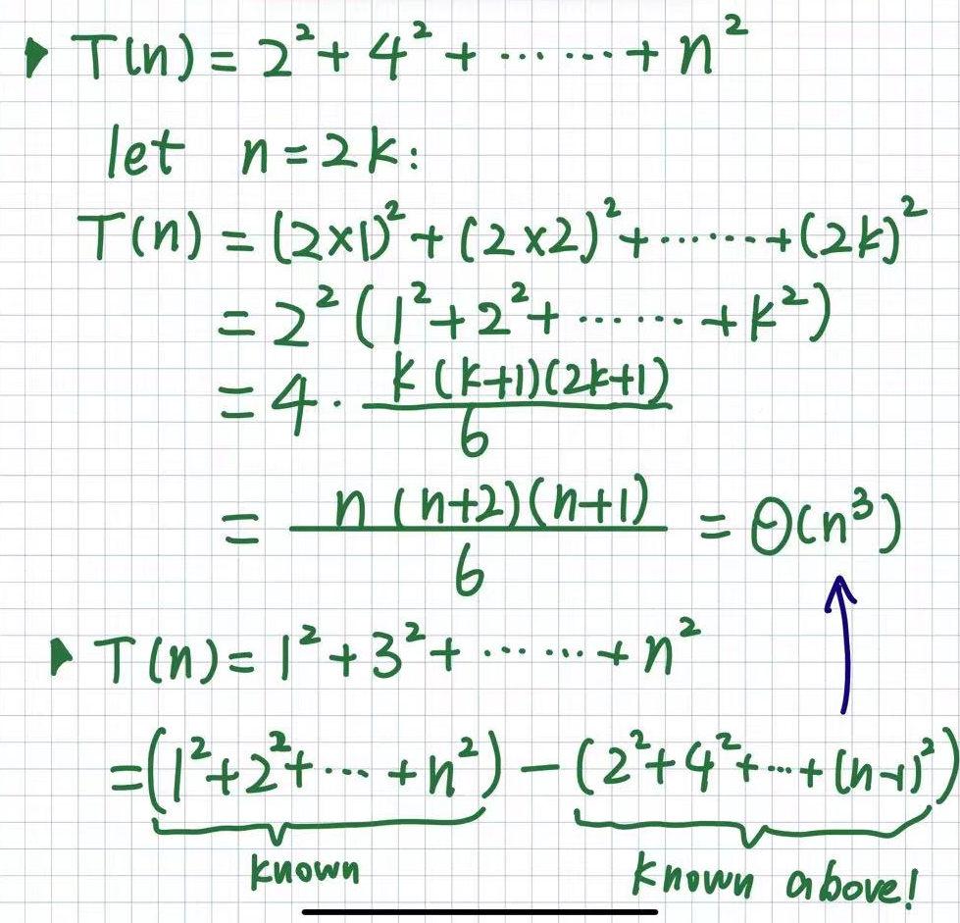
Question g: Expand the recursion (details)
Tricks to calculate:
- Sum of even squares
- Sum of odd squares

Slide 19
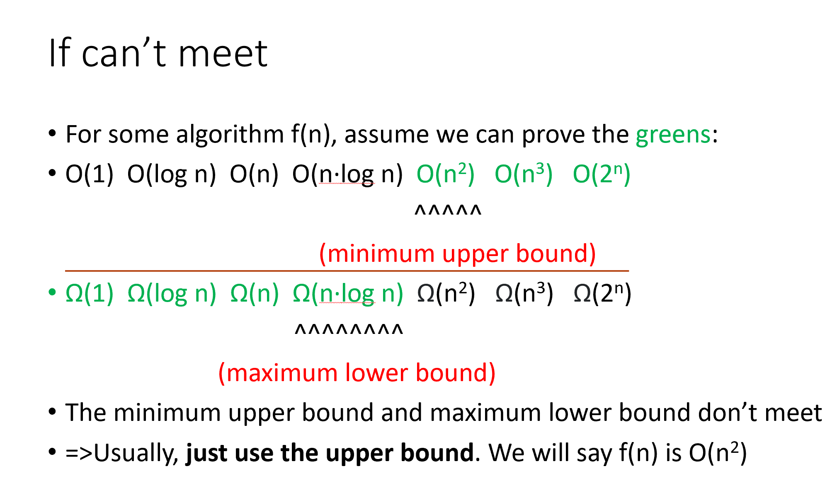
Look back: An example that upper/lower bounds does not meet (Will not be in exam)

Slide 20
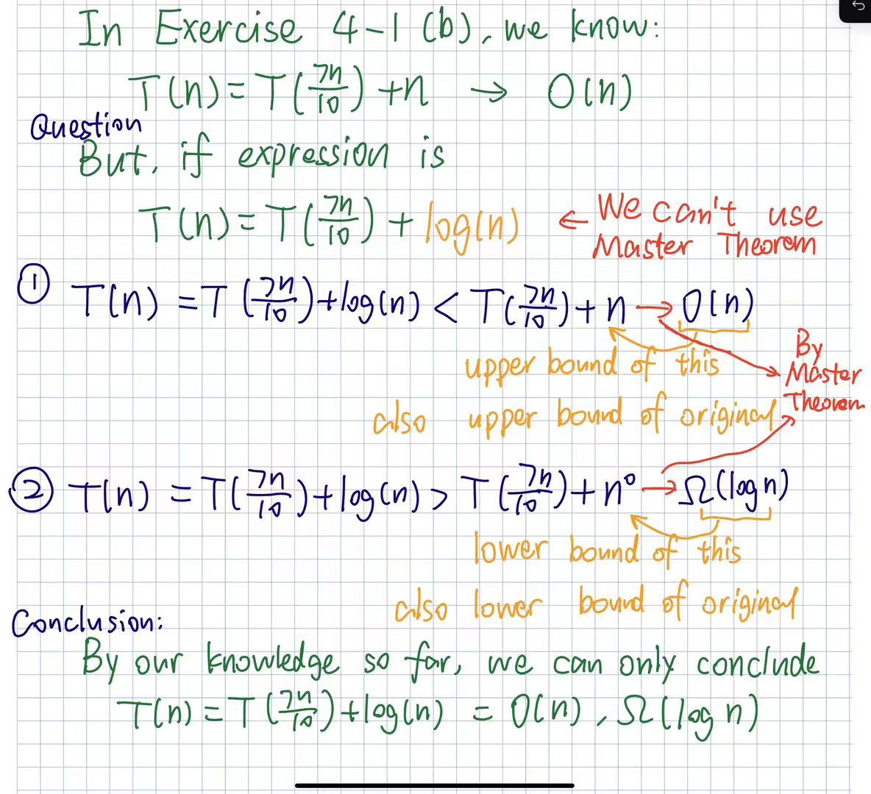
For expression like:
T(n) = T(7n/10) + log(n)
Cannot use Master Theorem.
--But we can do scaling (放缩)
--So we can find a good upper bound, O(n);
--And a good lower bound,
Ω(log n)!
(Will not be tested. Just for fun!)

Slide 21
Coding Question: Insertion Sort
We provide three languages (C++/Python/Java) of code, with corresponding reference answer on Blackboard.
The sorting function should **return void**, i.e., You need to modify in-place.
The problem is not difficult, but you need to think about “edge cases”.

Slide 22
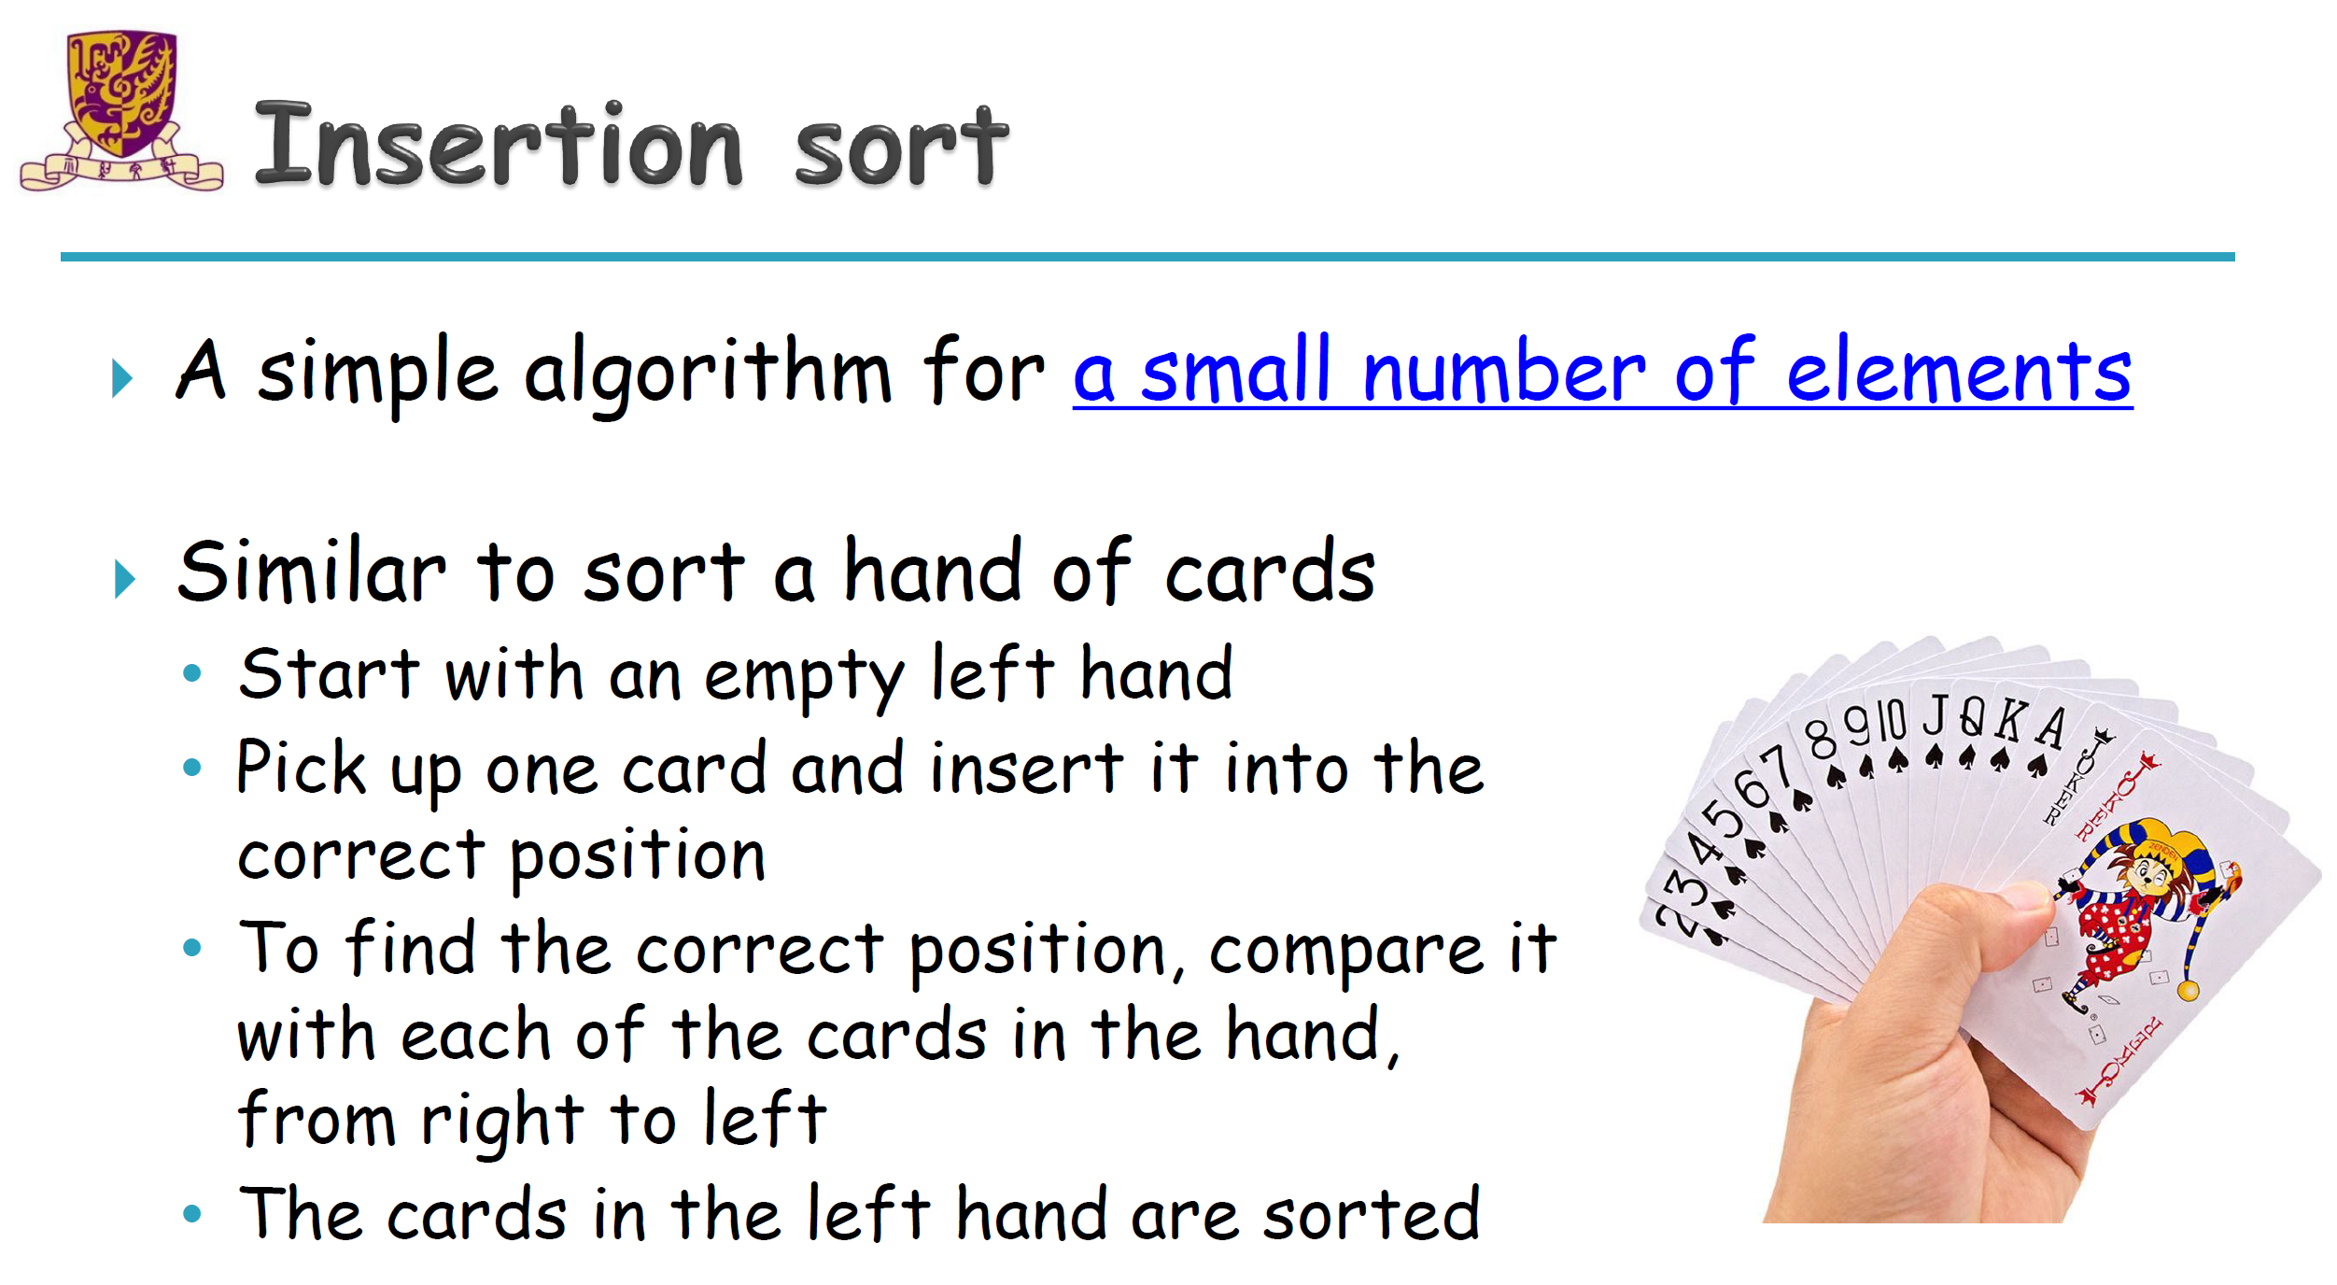
How It Works: average: O(n^2) best: O(n) worst: O(n^2)
Start with the second element (index 1) in the array, treating the first element as already sorted.
Compare the current element with the previous elements.
Insert the current element into the correct position by shifting the larger elements one position to the right.
Repeat the process for each of the elements in the array.
From Prof. Fang’s slides – lec 4 – page 4.

Slide 23
Thank you for coming!

